Slide 1




Careers within Data Analytics
May, 2020
Presented by: Manoj Kashyap

Slide 2

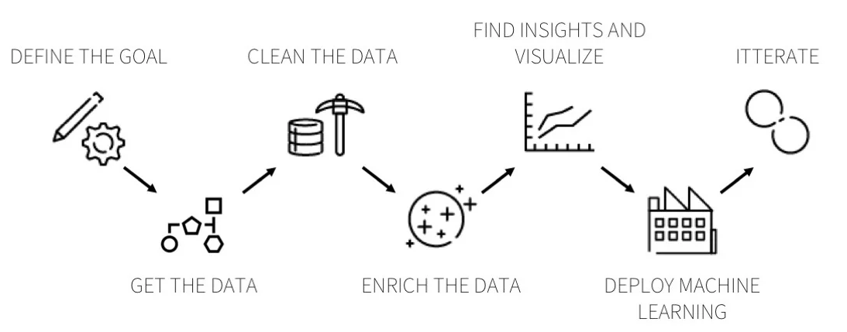
Major Steps in Analytical Project and Role players
Data engineer
Data analyst
Data scientist

Slide 3
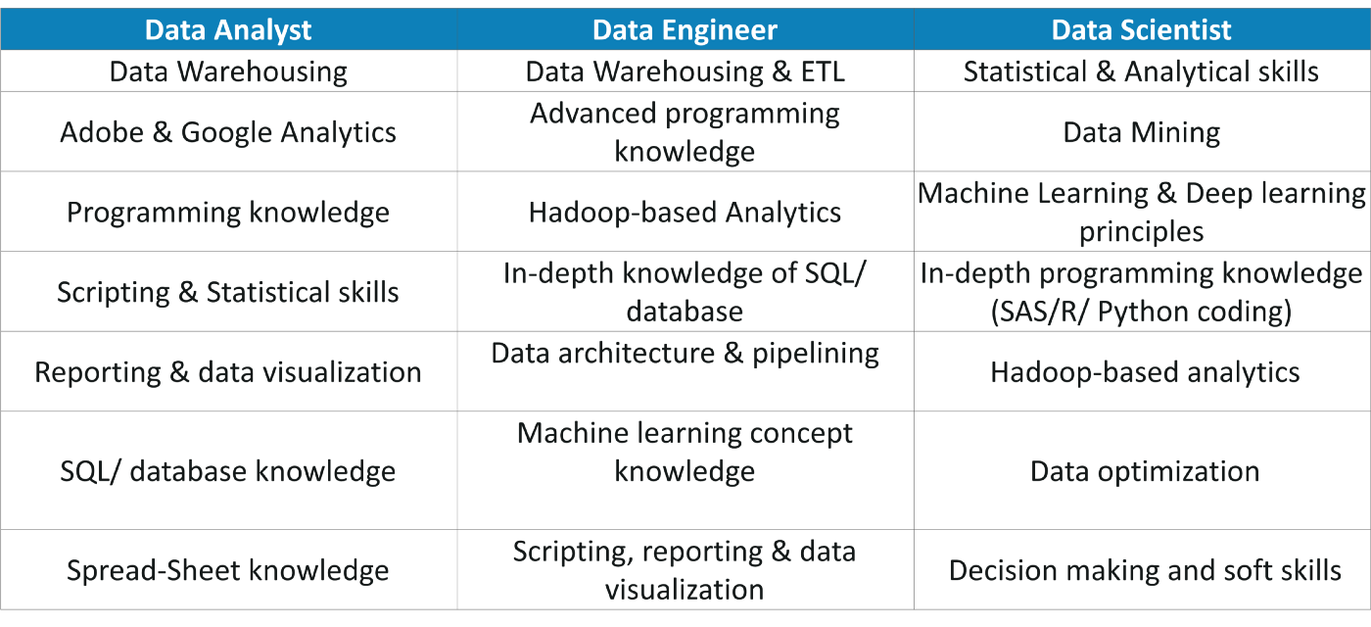
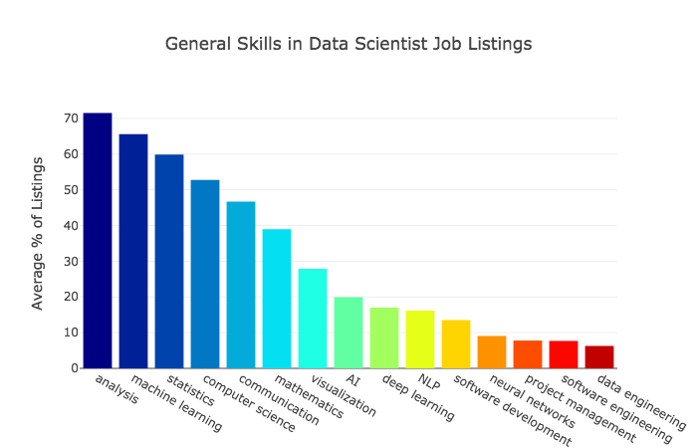
Employer Expectations and Skill Sets
Skill Sets
Corporate Expectations

Slide 4
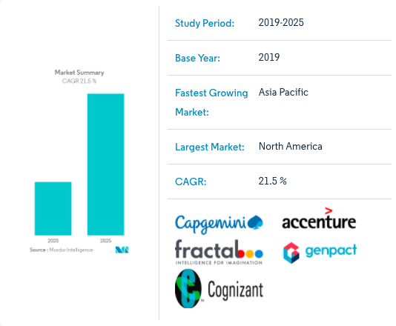
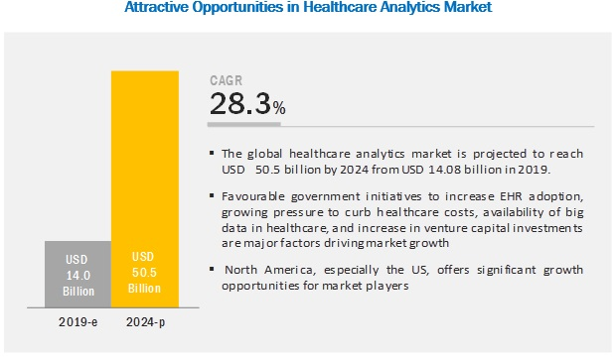
Growth in career opportunities over the next 5 years in Analytical domain
Overall Growth
Healthcare Sector

Slide 5
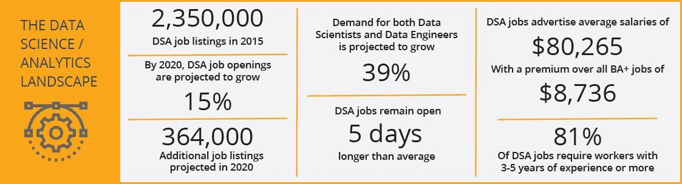
Salary Expectations
Opportunity are abundant
Highest Paying Industries For Data Analysts
Financial services
Manufacturing
Software as a Service (SaaS)
Healthcare

Slide 6
Grab your Job !!
Improve Statistical and Programming abilities
Market yourself: Blogs, LinkedIn, Kaggle, GitHub
Prepare an Outstanding Resume
Explain your project outcomes

Slide 7
Thank you

